Slide 1


Diplomado Xamarin
Day 4

Slide 2

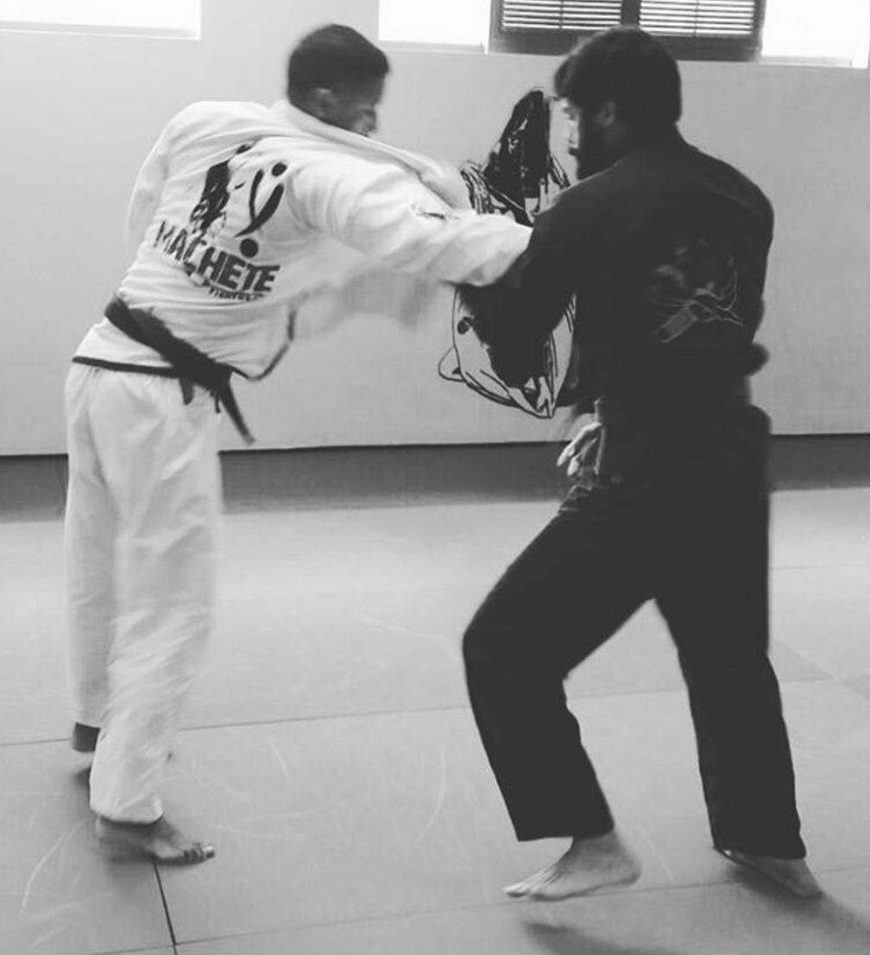

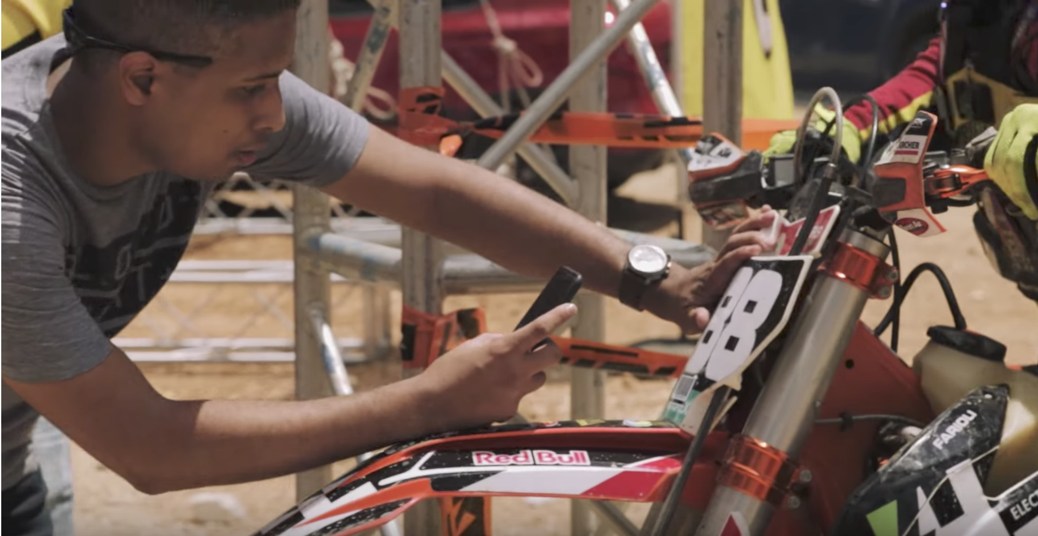
Hector Minaya
Megsoft Consulting
Email: hector@megsoftconsulting.com
Blog: https://medium.com/@hminaya
Twitter: @HectorMinaya

Slide 3

Agenda
Checklist
Day 3
Push Notifications
Demo
Lab
info@megsoftconsulting.com

Slide 4
Before we begin - Checklist
MAC
PC
IDE
Xamarin Studio 6.2.1 or
Visual Studio for MAC Preview (latest)
Java
JDK 1.8.0_121
Android SDK
Android 6.0
iOS SDK
X Code 8.3
IDE
Visual Studio 2017 w/ Xamarin for Visual Studio or
Visual Studio 2015 w/ Xamarin for Visual Studio (4.3.0.795)
Java
JDK 1.8.0_121
Android SDK
Android 6.0
Mac?
If you plan on testing with iOS then you need network access to a Mac w/ X Code 8.3
info@megsoftconsulting.com

Slide 5
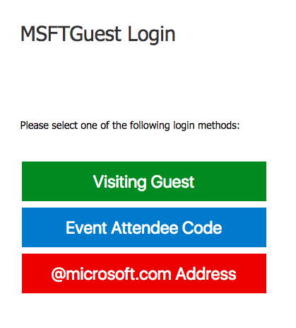
Wifi
SSID: MSFTGuest
Option: Event Attendee Code
Code: msevent17qd
info@megsoftconsulting.com

Slide 6
Day 3
Content
Materials
Xamarin & Azure
https://github.com/hminaya/DiplomadoMSDay3
http://bit.ly/DiplomadoXamarinDay3Tasks
info@megsoftconsulting.com

Slide 7
Push Notifications!
info@megsoftconsulting.com

Slide 8
Push Notifications!

Slide 9
Push Notifications!

Slide 10
Notes:
Platform Notification Systems (PNS)

Slide 11
Notes:
The Xamarin.Forms application registers with the PNS, which returns a handle.
The Azure Mobile Apps instance sends a notification to its Azure Notification Hub, specifying the handle of the device to be targeted.
The Azure Notification Hub sends the notification to the appropriate PNS for the device.
The PNS sends the notification to the specified device.
The Xamarin.Forms application processes the notification and displays it.

Slide 12
Demo
info@megsoftconsulting.com

Slide 13
Lab
Repository:
https://github.com/hminaya/DiplomadoMSDay4
Requirements:
http://bit.ly/DiplomadoXamarinDay4Tasks
info@megsoftconsulting.com

Slide 14
Feedback
http://bit.ly/FeedbackXam
info@megsoftconsulting.com

Slide 15


